Slide 1

Ducks: Oral Exam
Mikayla Winant: TL3

Slide 2
Software Engineering Principles
1.PUBLIC - Software engineers shall act consistently with the public interest.
2.CLIENT AND EMPLOYER - Software engineers shall act in a manner that is in the best interests of their client and employer consistent with the public interest.
3.PRODUCT - Software engineers shall ensure that their products and related modifications meet the highest professional standards possible.
4.JUDGMENT - Software engineers shall maintain integrity and independence in their professional judgment.
5.MANAGEMENT - Software engineering managers and leaders shall subscribe to and promote an ethical approach to the management of software development and maintenance.
6.PROFESSION - Software engineers shall advance the integrity and reputation of the profession consistent with the public interest.
7.COLLEAGUES - Software engineers shall be fair to and supportive of their colleagues.
8.SELF - Software engineers shall participate in lifelong learning regarding the practice of their profession and shall promote an ethical approach to the practice of the profession.

Slide 3
Copyright: Utilized Asset: Enemy Sprite
The four factors judges consider in fair use are:
Purpose and character of your use (nonprofit/educational vs. commercial) (transformative)
Nature of the copyrighted work (factual vs. creative)
Amount and substantiality of the portion taken.
Effect of the use upon the potential market
Transformative: In the video game, the enemy slime sprite is integrated into a larger interactive experience that involves unique gameplay, story, sound, and additional visual assets. This integration changes the context of the original slime sprite, making it a component of a broader work rather than a standalone asset. Transforming the sprite’s function within the game and placing it in a new, creative environment aligns with fair use principles.

Slide 4
Copyright: Utilized Asset: Enemy Sprite
Different Market and Purpose: When a purchased sprite is modified and integrated into a larger game, the market for the game is generally distinct from the market for the original sprite. The sprite, as sold, is intended for other developers to use in their own projects, not for end users to experience directly. By contrast, the market for the game appeals to players seeking interactive entertainment, rather than developers seeking reusable assets. This difference in audience and purpose helps support a fair use argument because the commercial game does not directly compete with or replace the need for the original sprite asset.
No Harm to Original Sprite Sales: If the original sprite is modified and only used within the context of a larger game, this generally doesn’t reduce the demand for the original sprite. Other developers can still purchase and use the original asset in their own projects, meaning the market for the sprite itself remains intact. As long as the game doesn’t sell the sprite in isolation or offer it in a way that competes with the original, there is minimal impact on the market for the asset.

Slide 5

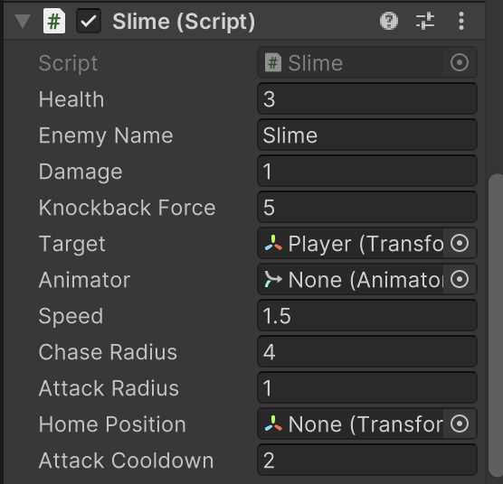
Prefab
Features:
Slime Enemy
How to Use:
Add prefab to hierarchy
Adjust script parameters such as Speed, Damage, Target, and Health to fit your game needs

Slide 6
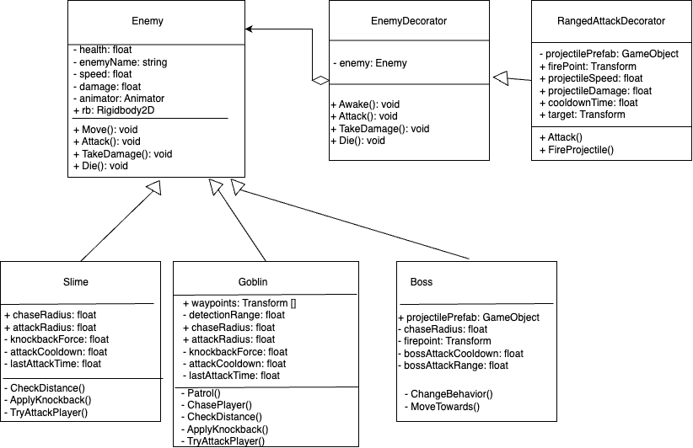
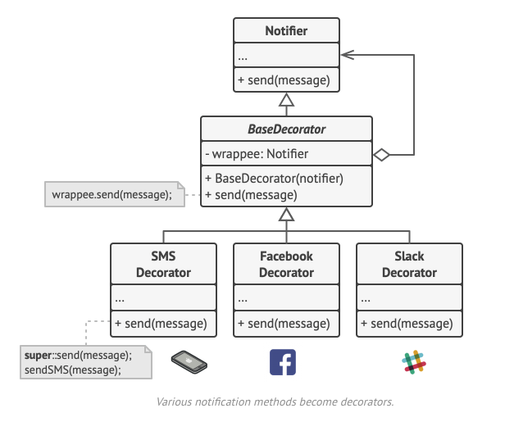
Decorator Pattern

Slide 7
Decorator Pattern: How it Works
Base Class: (Enemy) that defines general behavior for enemies.
Decorator Class: The RangedAttackDecorator inherits from Enemy and contains a reference to an Enemy instance. Instead of changing Enemy itself, the decorator "wraps" it, adding new methods like Attack() that implement ranged behavior.
Composition Over Inheritance: By applying the decorator, you avoid creating multiple subclasses for each possible behavior. Instead, you attach specific decorators as needed, adding just the behavior you want without altering the base class.

Slide 8
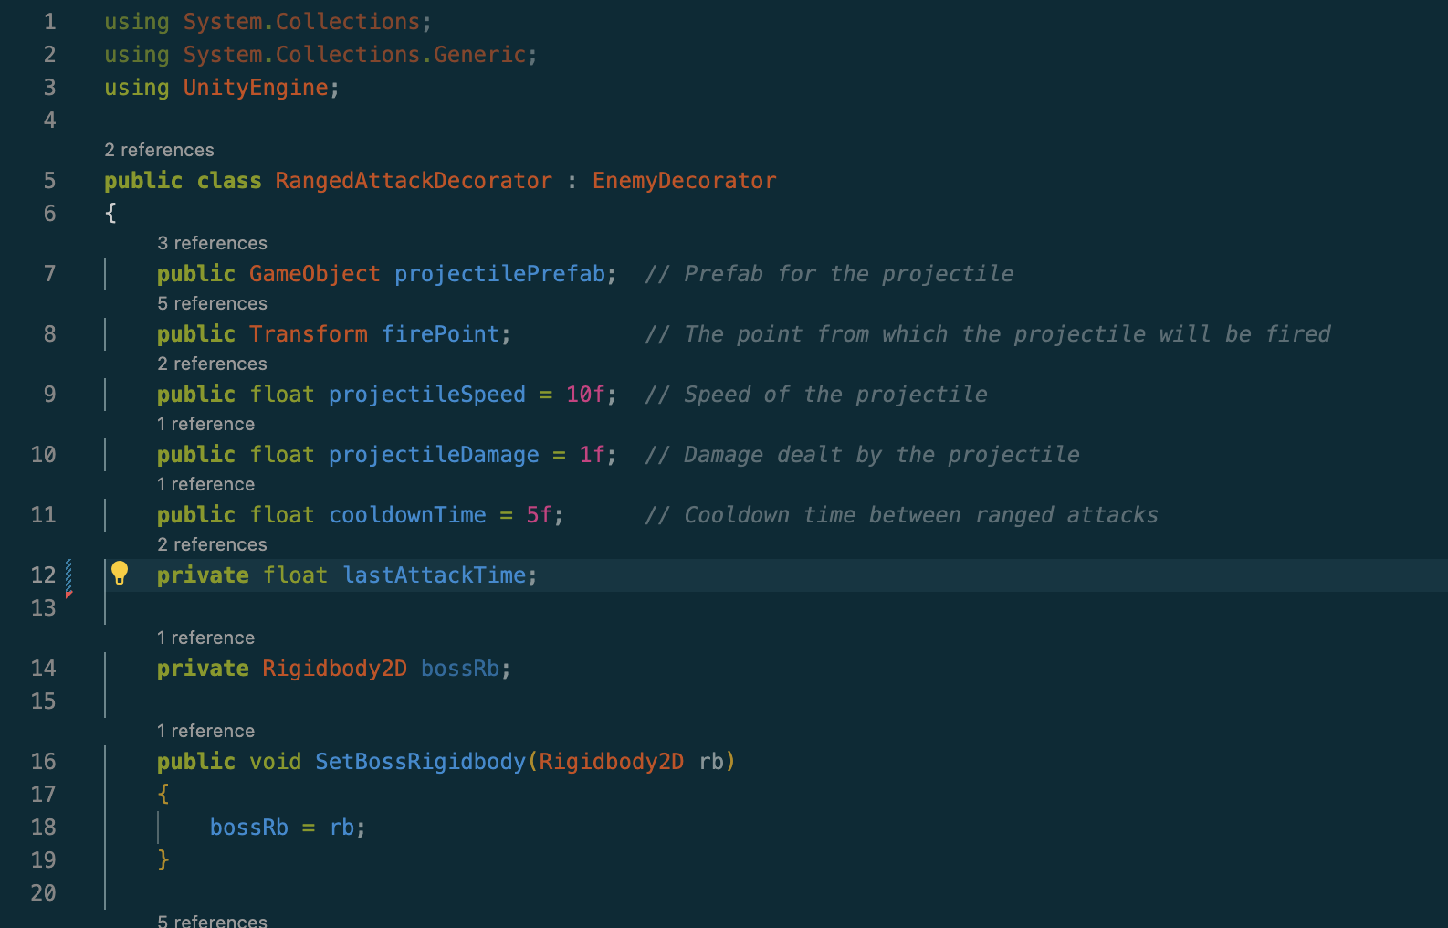
Decorator Code

Slide 9
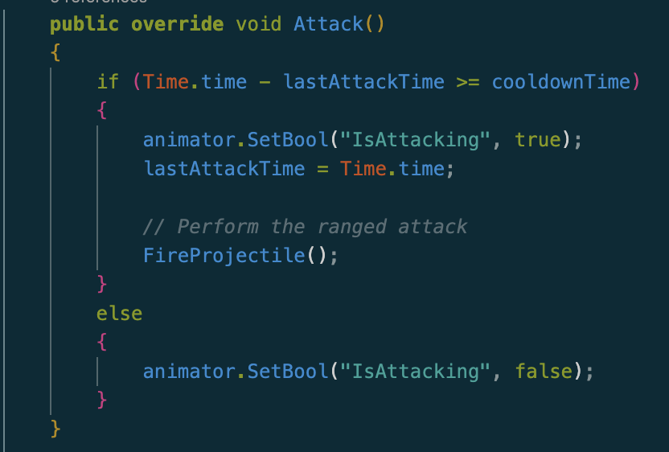
Decorator Code

Slide 10
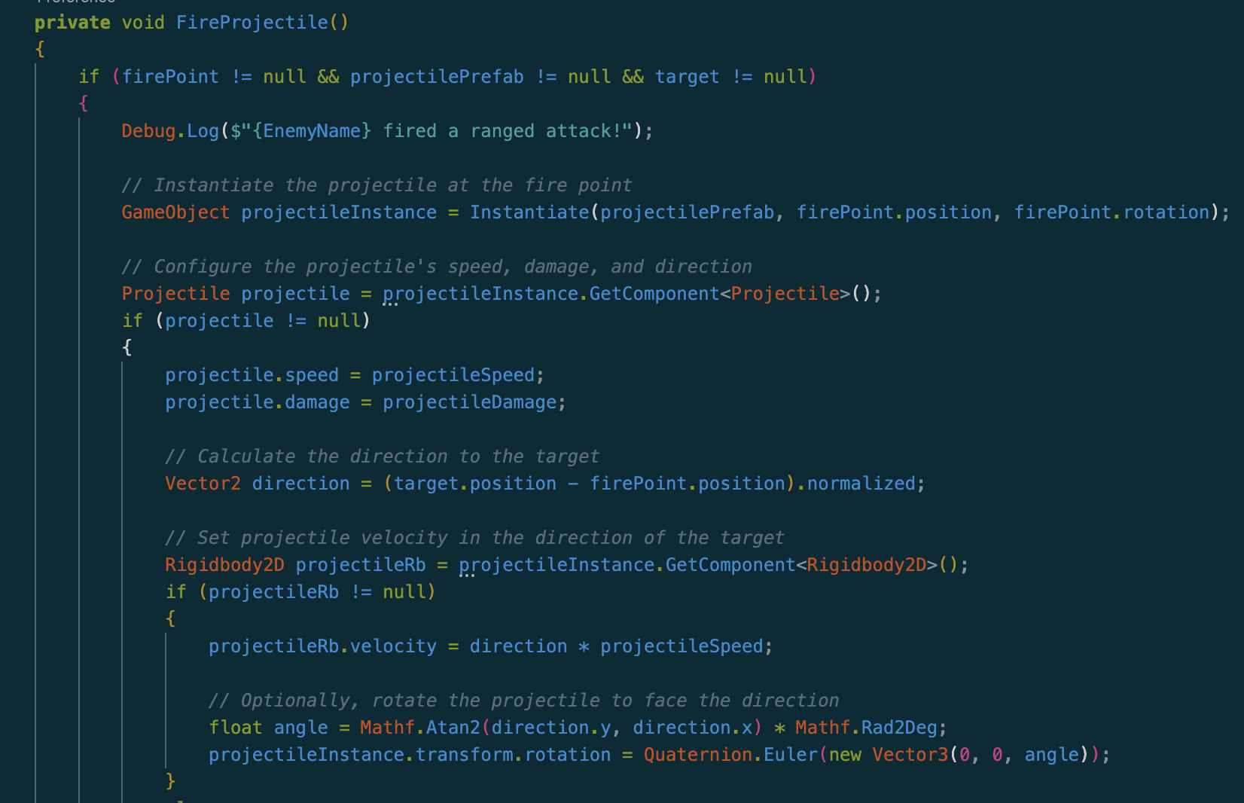
Decorator Code

Slide 11
Decorator Pattern Pros
Flexible Design
The decorator pattern lets you add functionality (like ranged attacks) to Enemy without modifying the base Enemy class directly.
Single Responsibility
Each decorator can be focused on a single behavior (e.g., ranged attacks), which promotes clean, modular code.
Easy Maintenance and Testing:
Keeping attack logic in a separate class allows you to test, maintain, and update attack behavior independently of other enemy functionality.

Slide 12
Decorator Pattern Cons
Complex Dependencies
Decorators that require additional dependencies (like RangedAttackDecorator needing a projectilePrefab or a firePoint) make the setup process more complicated.
Increased Code Complexity
Adding decorators increases code complexity, especially for simple games.

Slide 13
Test Plan

Slide 14
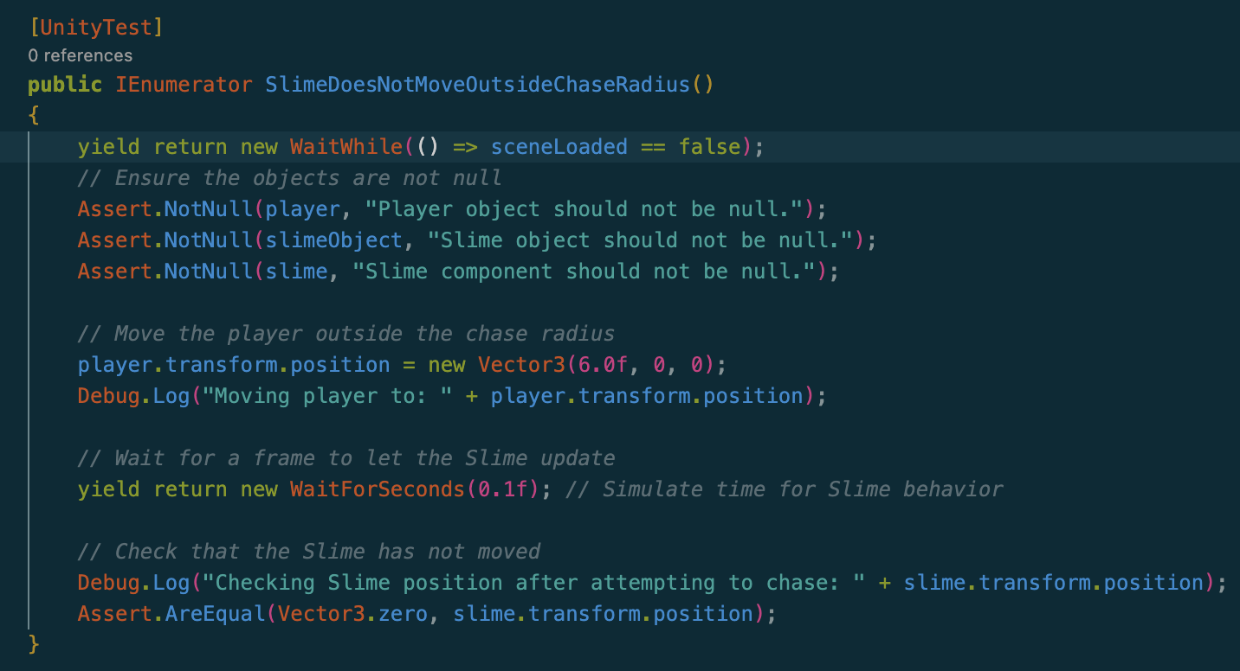
Mikayla’s Boundary Tests
Test that enemy does not move when player is outside chase radius.

Slide 15
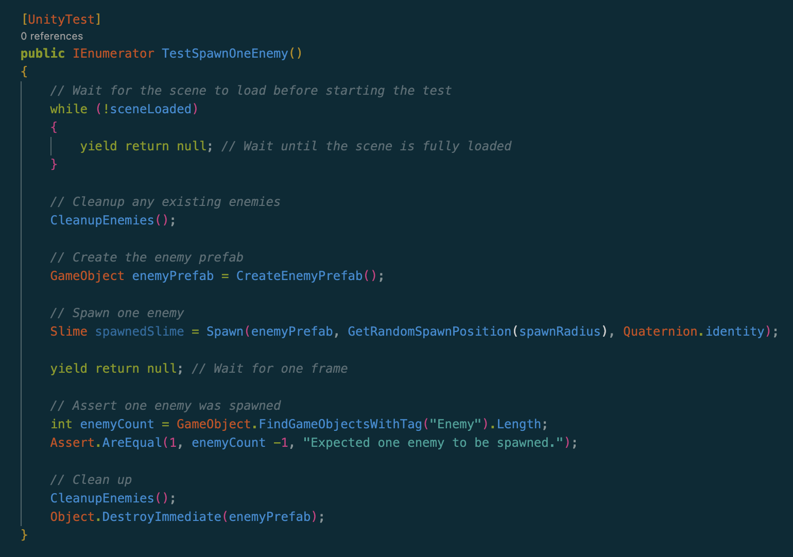
Mikayla’s Boundary Tests
2) Test that only one enemy is spawned when calling Spawn function.

Slide 16
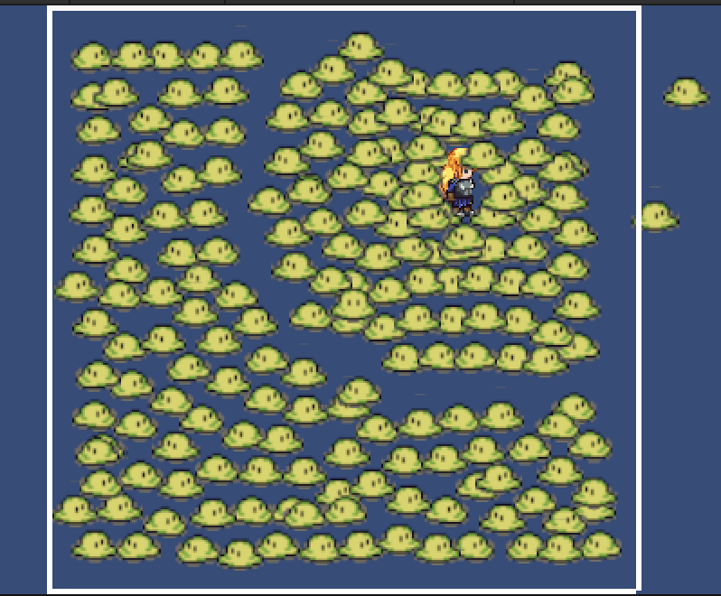
Mikayla’s Stress Test
Check max number of enemies that can be loaded into scene before wall physics are broken.

